Slide 1
AI-Powered Financial Advisory Chatbot: Revolutionizing Loan Application Automation and Optimization
Bank of Baroda Hackathon 2024
Your Team Name : TrioTech
Your team bio : Vasanth Bupathi S: Data science & cyber security enthusiast.
Gythiya sree V S V: AI & cloud computing specialist,
MERN stack developer.
Aishwarya R I: Civil engineering student, enthusiastic &
eager to learn.
Date : 30.6.2024

Slide 2
Problem Statement
Automating and Optimizing Loan Application Process with an AI-powered Financial Advisory Chatbot
The current loan application process is inefficient, inaccessible, and impersonal. Manual data entry, paper forms, and multiple touchpoints cause slow processing times and applicant frustration. Complex loan options and eligibility criteria confuse borrowers, leading to errors, incomplete applications, and frequent rejections. Borrowers rarely receive tailored advice on suitable loan options. These issues discourage potential borrowers and result in missed business opportunities for lenders due to slow processing and high rejection rates. To enhance borrower experience and improve lender efficiency, the loan application process must be streamlined, more accessible, and personalized.

Slide 3
Why did we decide to solve this Problem statement ?
Time-Consuming Traditional Methods: Visiting banks and consulting loan officers take considerable time.
Error-Prone Manual Applications: Filling out applications manually often leads to errors.
Inefficiencies and Poor User Experience: These issues result in inefficiencies and an unsatisfactory user experience.
Complex Paperwork Requirements: Confusing paperwork can delay loan processing.
Limited Accessibility to Personalized Advice: Lack of personalized financial guidance complicates decision-making.
Navigating Multiple Loan Schemes: Users struggle to choose the most suitable loan option from many available schemes.
Managing Timely Interest Payments: Users often find it difficult to manage interest payments due to forgetfulness or inadequate preparation.

Slide 4
Pre-Requisite
Digital lending platforms : Digital lending platforms like Rocket Mortgage and Quicken Loans offer online applications, automated credit checks, and document verification, speeding up processing and enhancing convenience.
CRM systems such as Salesforce and Zoho CRM centralize borrower information, automate follow-ups, and streamline approval processes, improving organization and communication.
Self-service portals from major banks allow borrowers to initiate and track applications online, upload documents, and receive personalized loan offers and real-time updates, reducing bank visits and empowering borrowers.
Online financial tools from Bankrate and NerdWallet provide loan calculators, product comparisons, and financial planning resources, aiding decision-making.
E-banking and mobile banking apps like those from Ally Bank and Discover Bank offer mobile-friendly applications, push notifications, secure messaging, and access to financial education resources, enhancing accessibility and providing real-time updates.

Slide 5
Tools or resources
1. Azure Cognitive Services (Language Understanding - LUIS):
Enhances chatbot's ability to understand user intents and extract entities from natural language input, improving loan eligibility assessment and product recommendations.
2. Azure Machine Learning:
Develops and deploys predictive models for analyzing user data, predicting loan eligibility, recommending loan schemes, and personalizing repayment schedules.
3. Azure SQL Database:
Securely stores structured data including user profiles, loan applications, ensuring scalability, reliability, and high availability for chatbot operations.
4. Azure Functions:
Provides serverless compute for executing backend tasks such as processing loan applications, integrating with APIs, and managing business logic efficiently and cost-effectively.

Slide 6

Solution
To design and develop an AI-powered financial advisory chatbot capable of automating the loan application journey. The chatbot will efficiently determine loan eligibility by analyzing user-provided data, recommend appropriate loan schemes based on comprehensive criteria including business type, location, and property details, generate personalized repayment schedules tailored to user preferences, estimate property values accurately through integrated services or APIs, and facilitate the online submission of loan applications. Through these capabilities, the chatbot aims to optimize the loan application process, enhance operational efficiency, and provide accurate financial advisory services aligned with the unique requirements of each user.

Slide 7
Methodology
Data Collection and Analysis: The chatbot collects user-provided data such as financial details, business type, location, and property specifics. It analyzes this data using algorithms to determine the user’s eligibility for different loan schemes.
Personalized Recommendations: Based on the analysis, the chatbot recommends suitable loan schemes tailored to the user’s profile and preferences. Recommendations consider factors like income, credit history, business details, and property values obtained through integrated APIs.
Customized Repayment Planning :The chatbot generates personalized repayment schedules based on loan amount, interest rates, and user preferences. It presents these schedules in an interactive format, allowing users to adjust parameters for optimal repayment planning.
Facilitated Application Submission: Guiding users through the online application process, the chatbot assists in completing forms and uploading necessary documents. It ensures accuracy and completeness, streamlining the application submission and verification process.

Slide 8
Functionalities
Interactive Loan Application Portals: User-friendly web portals or mobile applications that guide applicants through the loan application process with intuitive interfaces and step-by-step guidance.
Automated Loan Eligibility Calculators: Tools that allow users to input their financial details to instantly determine loan eligibility and receive recommendations for suitable loan products.
Virtual Loan Officers: AI-driven virtual assistants that provide real-time responses to user queries about loan products, eligibility criteria, and application processes.
Integrated APIs for Property Valuation: APIs that fetch real-time property valuation data to assist users in accurately estimating property values required for loan applications.

Slide 9

Key Differentiators & Adoption Plan
Key Differentiators:
Automation: Automates the loan application process, reducing manual effort and time.
Personalization: Offers tailored loan recommendations and repayment schedules based on user-specific data.
Accuracy: Utilizes AI for precise eligibility assessments and property valuations, minimizing errors.
Convenience: Accessible via web and mobile platforms, ensuring convenience for users.

Slide 10
Key Differentiators & Adoption Plan
Adoption Plan:
Demonstration and Proof of Concept: Showcase successful case studies and live demonstrations to highlight the effectiveness and ease of use of the chatbot.
Partnerships and Integration: Collaborate with financial institutions to integrate the chatbot into their systems, making it readily available to their customers.
Feedback and Iteration: Collect user feedback to continuously improve the chatbot's features and user experience, ensuring it meets evolving user needs.
Marketing and Promotion: Implement targeted digital marketing campaigns, utilize social media platforms, and participate in industry events to raise awareness and attract a broader user base.

Slide 11
Uniqueness of Approach and Solution
Automated Personalization:
Tailors loan recommendations and repayment schedules to individual user needs.
Uses advanced AI to analyze user data for personalized advice.
Integration of Multiple Services:
Combines loan eligibility checks, property valuation, and loan application submission in one platform.
Provides a seamless, end-to-end user experience.
Enhanced Accuracy and Efficiency:
Utilizes real-time data and machine learning algorithms for precise property valuations and financial assessments.
Speeds up the loan application process, reducing manual intervention.
Robust Security Measures:
Employs data encryption, authentication, and regular security audits.
Ensures regulatory compliance and data protection.
User-Friendly Interface:
Offers a conversational interface for easy user interaction.
Provides intuitive guidance through complex financial decisions.
Scalability and Adaptability:
Designed to handle large volumes of transactions and users efficiently.
Adaptable to various financial products and markets.

Slide 12


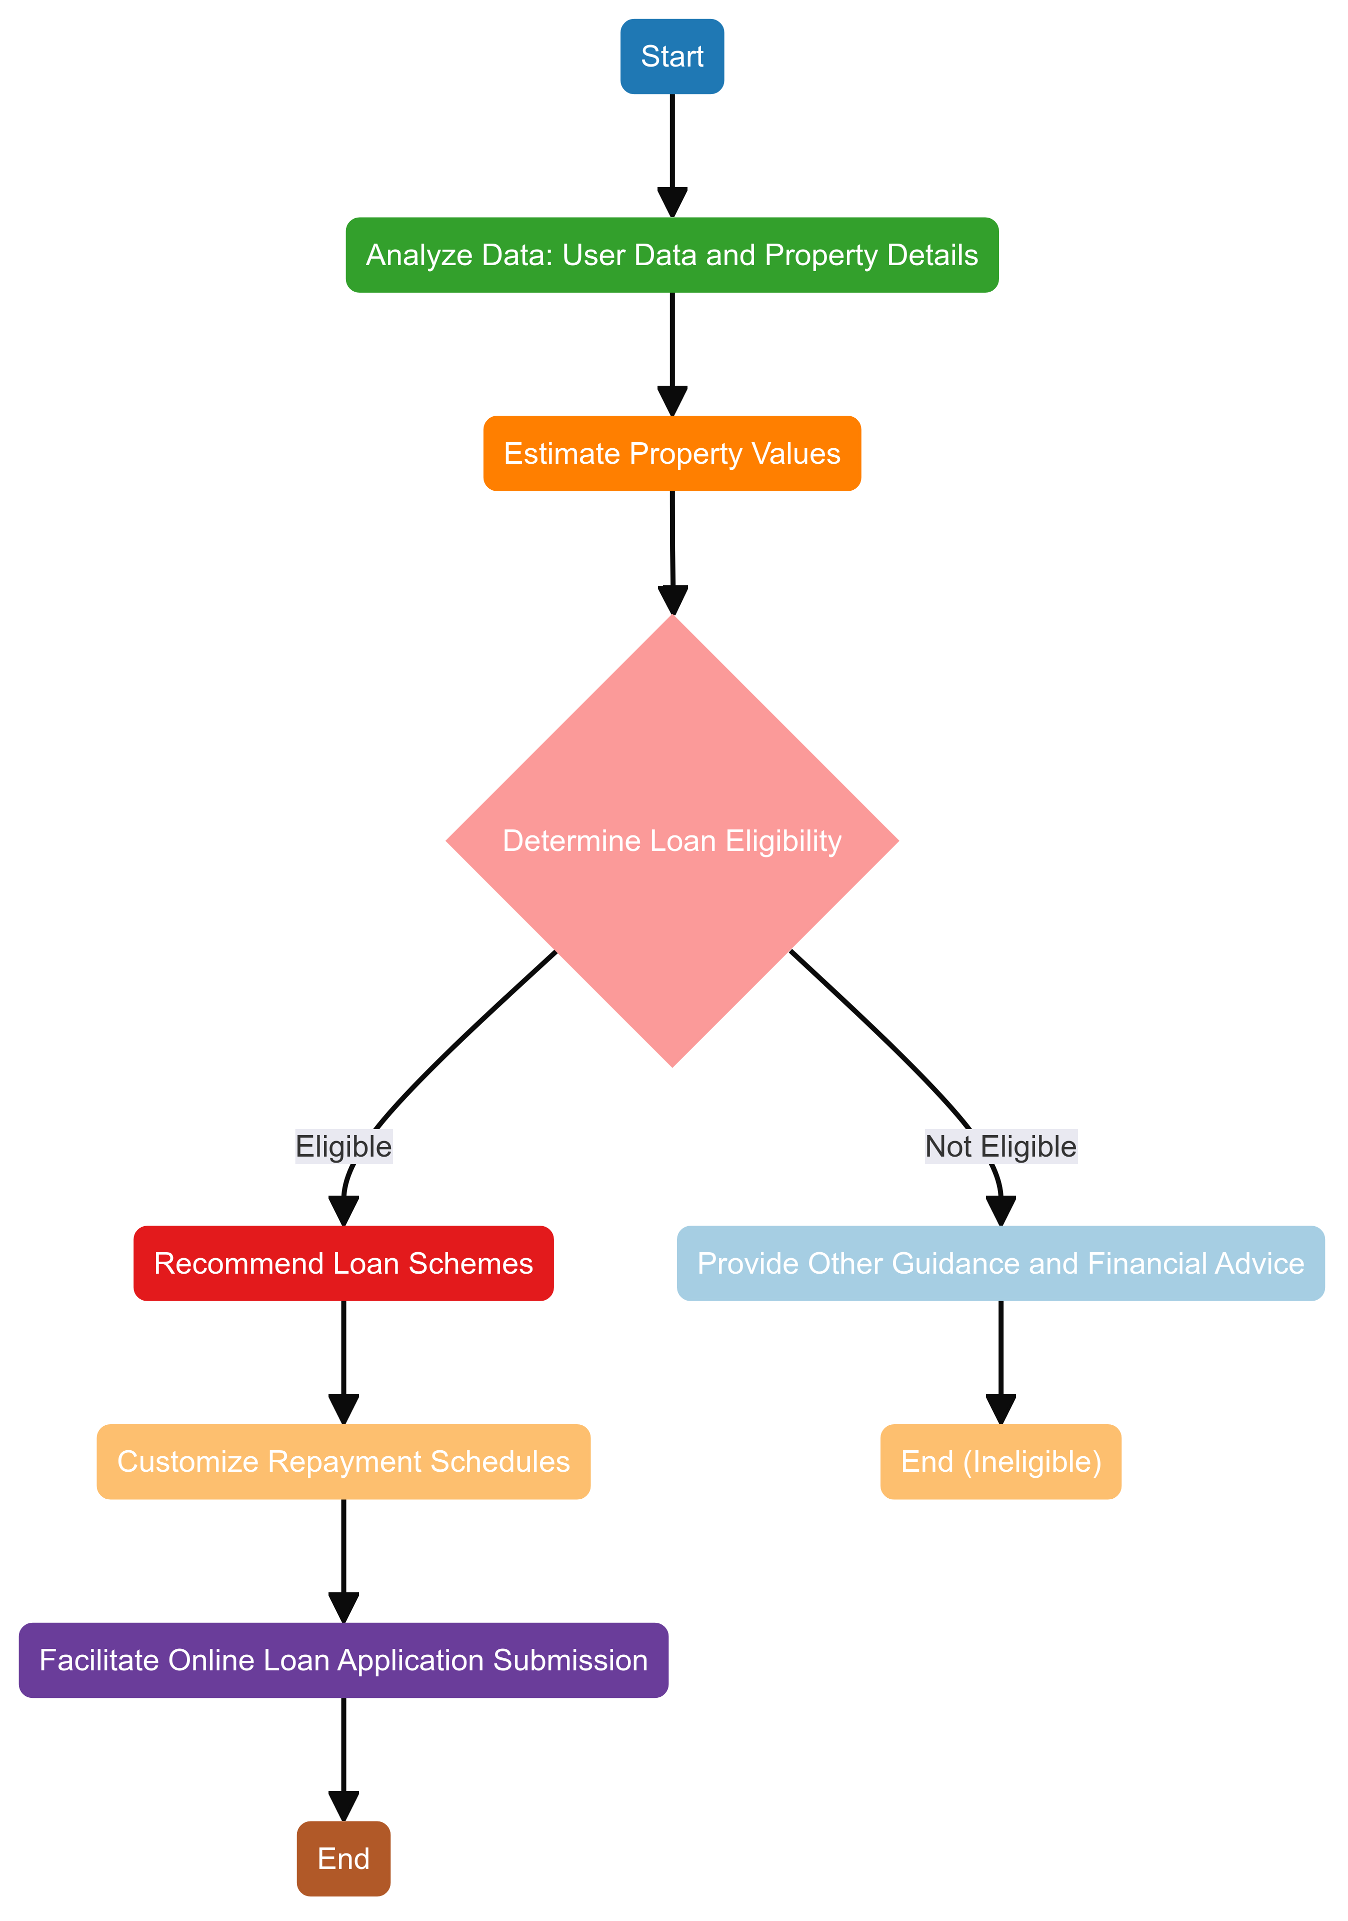
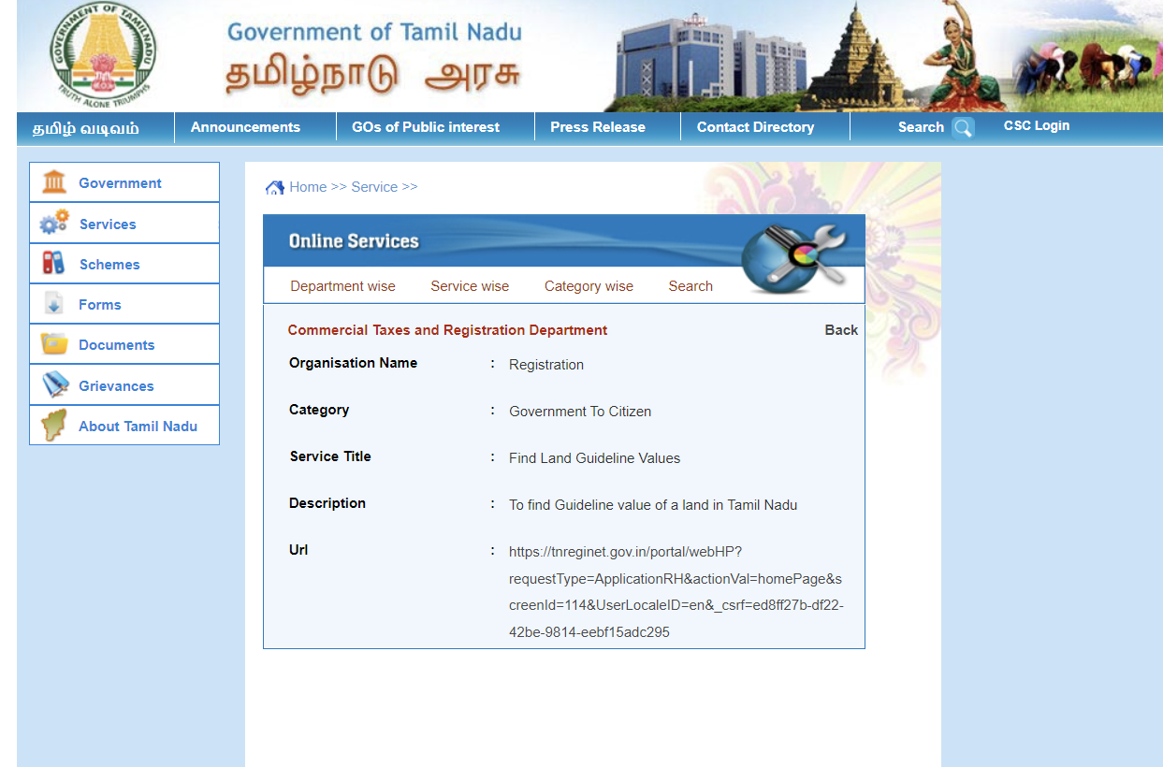
Supporting diagrams

Slide 13
Business Potential and Relevance
Financial Institutions: Streamlines loan processing and improves customer service.
Fintech Companies: Enhances digital services and scalability.
Real Estate: Provides accurate property valuations and financing advice.
Insurance: Assists with risk assessment and customer engagement.
Retail/E-commerce: Facilitates consumer financing and boosts loyalty.
Government: Supports financial inclusion and public finance initiatives.

Slide 14
User Experience
Efficiency: By automating loan eligibility determination and personalized recommendations, users can quickly understand their financial options without extensive manual processes.
Personalization: Tailored loan scheme recommendations and customized repayment schedules cater to individual user needs, enhancing relevance and satisfaction.
Accuracy: Accurate property valuation and precise financial advice based on real-time data ensure users receive reliable information to make informed decisions.
Convenience: Facilitating online loan application submissions simplifies the process, making it more accessible and convenient for users to apply for loans anytime, anywhere.
Security: Incorporating robust security measures instills trust and confidence in users, ensuring their sensitive financial data is protected throughout interactions with the chatbot.

Slide 15
Scalability
Cloud Infrastructure: Utilize scalable platforms like Microsoft Azure to manage increasing user demand without performance issues.
Load Balancing: Distribute traffic across multiple servers to prevent overload and ensure optimal performance.
Horizontal and Vertical Scaling:
- Horizontal Scaling: Add more instances to handle more users and distribute the workload.
- Vertical Scaling: Enhance server power (CPU, RAM) for handling intensive tasks.
Optimized Algorithms: Continuously refine algorithms and data processing for better performance and faster response times.
Monitoring and Analytics: Use real-time tools to monitor performance, user interactions, and resource usage for proactive planning.
Continuous Improvement: Regularly update AI models and NLP capabilities based on feedback and usage to maintain responsiveness and effectiveness.

Slide 16
Ease of Deployment and Maintenance
Cloud-Based Infrastructure: Hosted on scalable cloud platforms like Microsoft Azure for flexibility and reliability.
User-Friendly Interface: Intuitive interface for both customers and administrators.
Modular Architecture: Easy integration, updates, and scalability.
Automated Deployment: Seamless updates with automated deployment pipelines..
Comprehensive Documentation: Detailed setup, integration, and troubleshooting guides.
Continuous Monitoring: Real-time performance tracking and issue identification.
Routine Maintenance Automation: Automated scripts for regular maintenance tasks.
Customer Support and Training: Robust support and training resources.

Slide 17
Security Considerations
Data Encryption: Encrypt data at rest and in transit.
Authentication and Authorization: Use multi-factor authentication (MFA) and role-based access control (RBAC).
Regular Security Audits: Perform regular security assessments and penetration testing.
Regulatory Compliance: Adhere to GDPR, HIPAA, and other relevant standards.
Secure APIs: Ensure API endpoints are authenticated, authorized, and encrypted.
Intrusion Detection/Prevention: Implement IDS and IPS to monitor and block malicious activities.
Software Updates: Regularly update software to protect against vulnerabilities.
Data Backup and Recovery: Establish robust backup and recovery procedures.
User Training: Provide security training to users.
Audit Logs: Maintain detailed audit logs for monitoring and accountability.

Slide 18
Thank You
TEAM MEMBERS:
Vasanth Bupathi S
Aishwarya R I
Gythiya sree V S V

